Slide 1
Section 7.7
Graphs of the Tangent, Cotangent, Cosecant, and Secant Functions
Copyright © 2012 Pearson Education, Inc. Publishing as Prentice Hall.

Slide 2
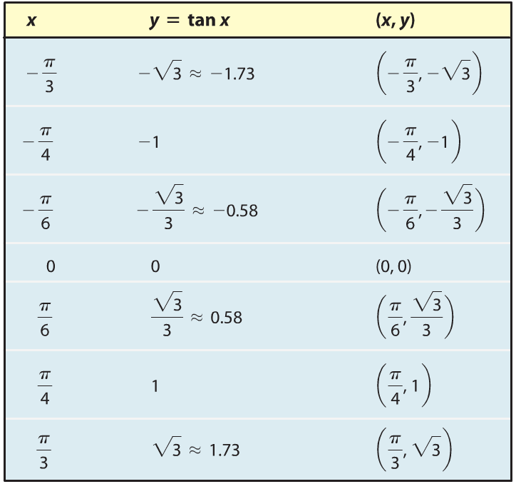
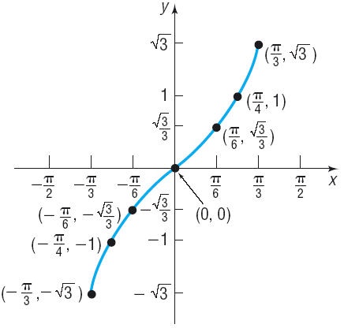
Copyright © 2012 Pearson Education, Inc. Publishing as Prentice Hall.

Slide 3
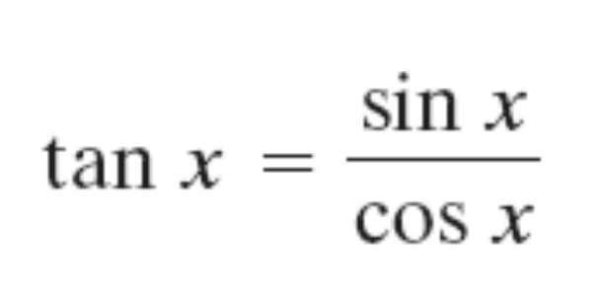
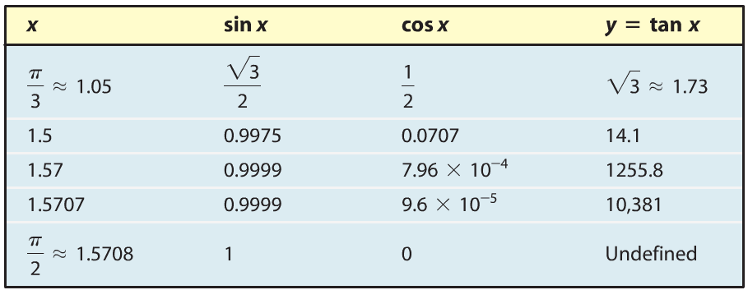
Copyright © 2012 Pearson Education, Inc. Publishing as Prentice Hall.

Slide 4
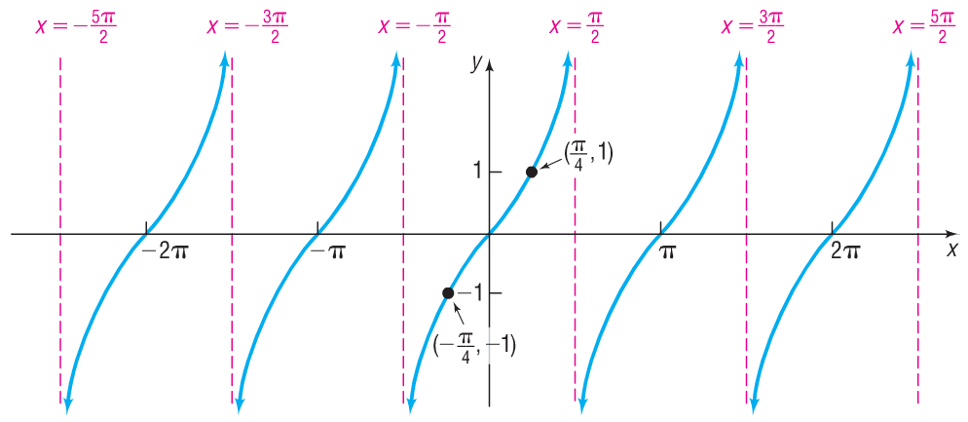
Copyright © 2012 Pearson Education, Inc. Publishing as Prentice Hall.

Slide 5
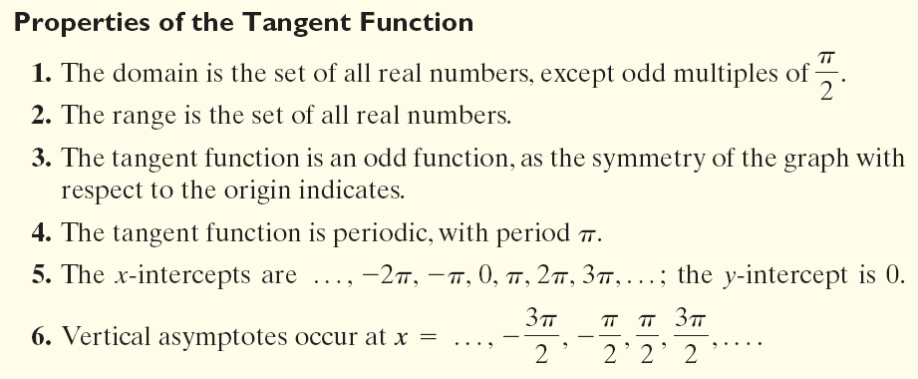
Copyright © 2012 Pearson Education, Inc. Publishing as Prentice Hall.

Slide 6

Copyright © 2012 Pearson Education, Inc. Publishing as Prentice Hall.

Slide 7

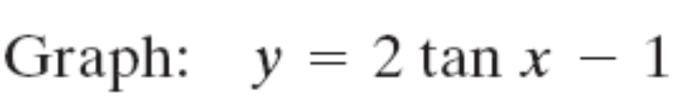
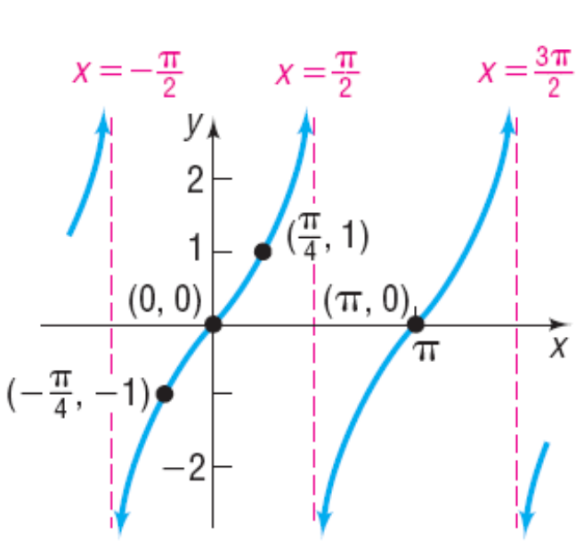
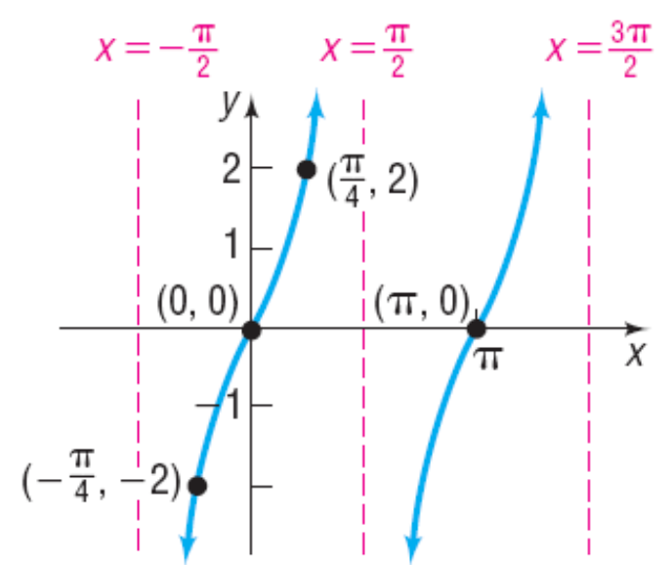
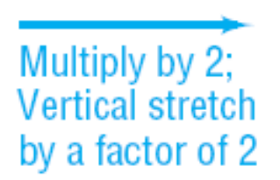
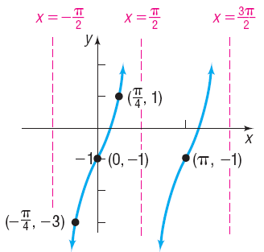

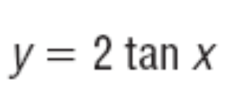
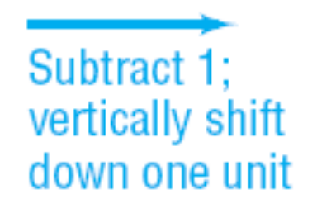
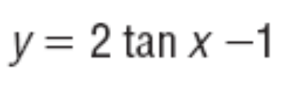
Copyright © 2012 Pearson Education, Inc. Publishing as Prentice Hall.

Slide 8
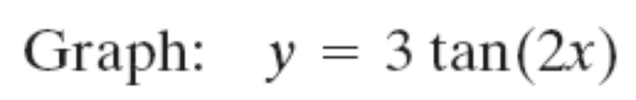
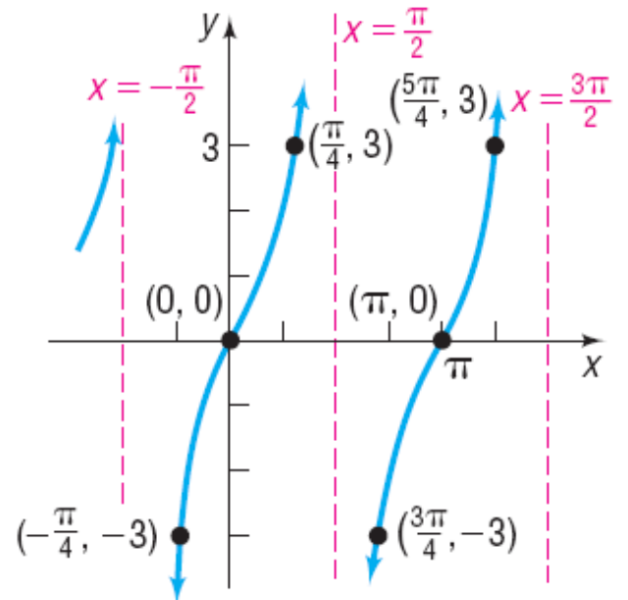
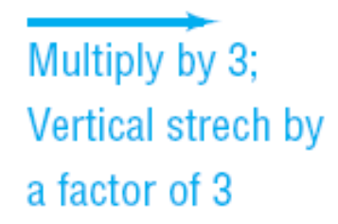
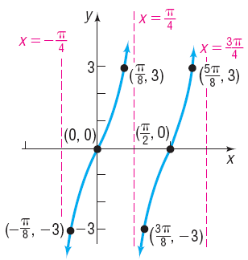
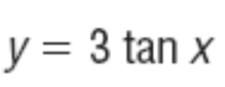
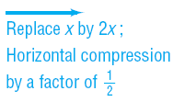

Copyright © 2012 Pearson Education, Inc. Publishing as Prentice Hall.

Slide 9
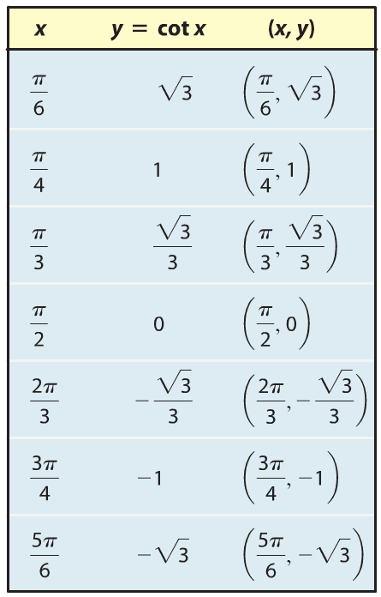
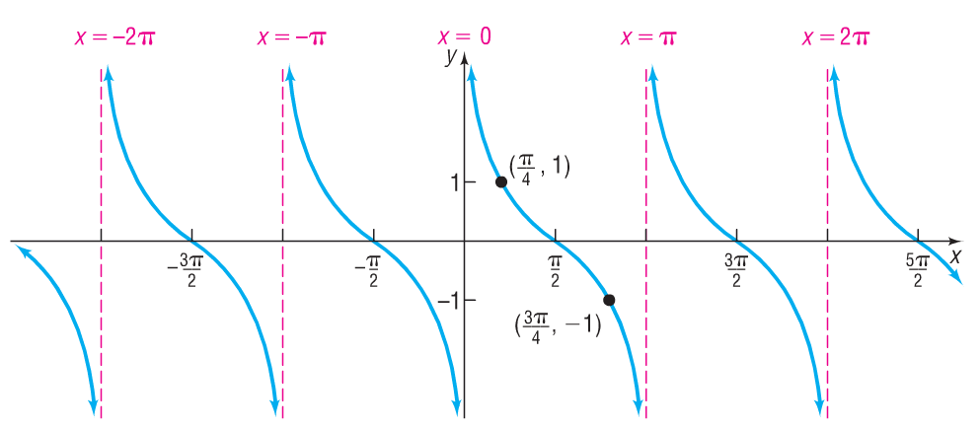
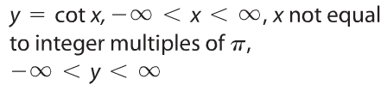
Copyright © 2012 Pearson Education, Inc. Publishing as Prentice Hall.

Slide 10
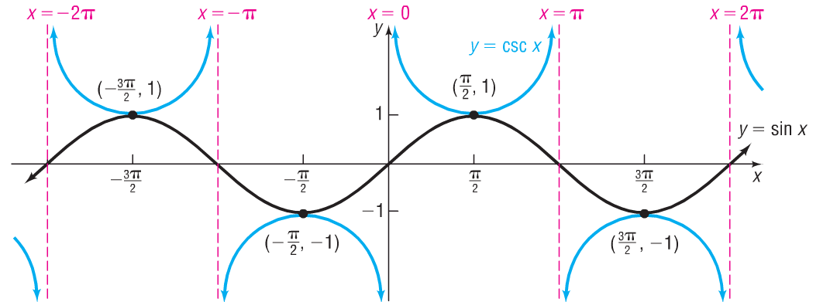

Copyright © 2012 Pearson Education, Inc. Publishing as Prentice Hall.

Slide 11
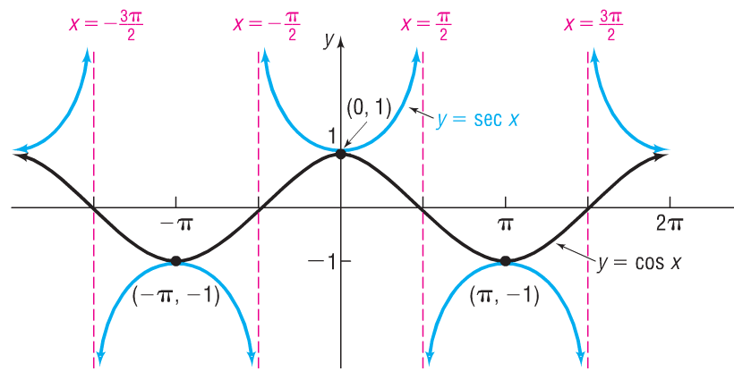
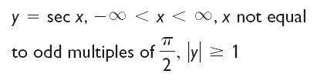
Copyright © 2012 Pearson Education, Inc. Publishing as Prentice Hall.

Slide 12
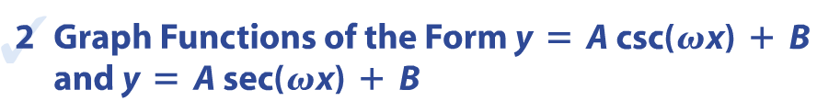
Copyright © 2012 Pearson Education, Inc. Publishing as Prentice Hall.

Slide 13

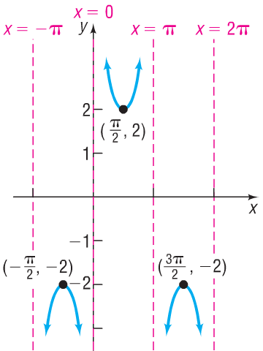
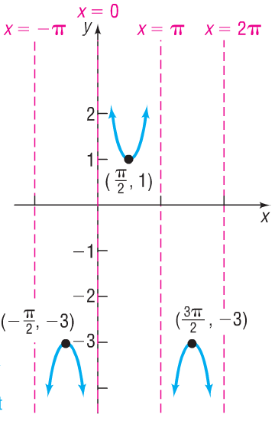
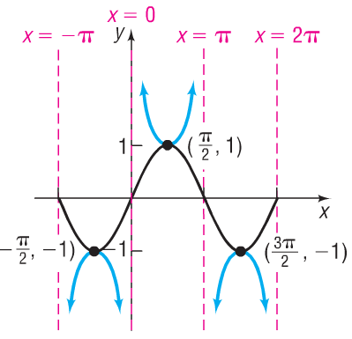
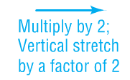
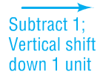



Copyright © 2012 Pearson Education, Inc. Publishing as Prentice Hall.

